Slide 1
Achievement in Earlston High School
Presentation to Parent Council
March 2015

Slide 2
Key Questions
What is Achievement?
Why is Achievement important?
What are the Achievement opportunities in EHS?
How is Achievement embedded into the curriculum?
What are the Achievement opportunities out of school?
How is Achievement recorded and recognised?
How can parents/carers help?

Slide 3
What is Achievement?

Slide 10
What is Achievement?
Achievement can be considered as: positive experiences, evidencing and developing transferable employability and life skills and qualities in the process.

Slide 11
QUALITIES |  | SKILLS
Confident |  | Teamwork
Resilient/Determined |  | Problem Solving
Motivated |  | Talking
Assertive |  | Listening
Calm |  | Negotiation
Respectful |  | Using ICT effectively
Integrity |  | Creativity
Compassionate |  | Written Communication
Sense of Fairness and Justice |  | Numeracy
Commitment |  | Literacy
Honest |  | Organisation
Responsible |  | Quick Learner
Caring/Kind |  | Meeting Deadlines
Cooperative |  | Showing Initiative
Humourous |  | Reflection
Enthusiastic |  | Research
Friendly |  | Budgeting
Competitive |  | Coaching
Meticulous/Precise |  | Decision Making
Conscientious |  | Leading/Managing others
Reflective/Thoughtful |  | Practical Skills
Punctual |  | Time Management
Encouraging |  | Keyboarding
Flexible/Adaptable |  | Specific talent (eg singing, playing tennis, drawing..)

Slide 13
What do teachers do to help improve/better recognise achievement of students?
Get involved in House events
Be a positive role model and share own achievements
Use the Merit system consistently
Organise and be involved in trips and excursions
Have a range of learning/assessment experiences to allow students to evidence different skills and qualities
Highlight to parents/carers the importance of wider achievement
Be aware of the ‘Learner Journey’ and what this entails – this includes career planning, social development as well as attainment and wider achievement.
Talk to students about work experience and volunteering
Regularly access the school Achievement website and look at Hall of Fame noticeboards throughout the school to be aware of individual successes – use this to motivate and encourage others
Offer other short courses and awards – eg DoE, ASDAN
Offer lunchtime and/or out of school clubs. Be aware of out of school opportunities locally and publicise these to individuals/classes.
Work collaboratively with partner agencies
Create leadership opportunities in your department
Recognise and celebrate subject-related achievements (eg competition winners) on faculty noticeboards
Have an active role in helping with Achievement Awards ceremonies/assemblies

Slide 16
Using Glow/e-portfolios
All achievements can be logged electronically. We are currently developing OneNote classbooks for this purpose and will launch these through P7 classes for all catchment schools in May/June 2015. Part of the development and launch will be to create a series of information leaflets to help teachers, pupils and parents/carers.

Slide 17
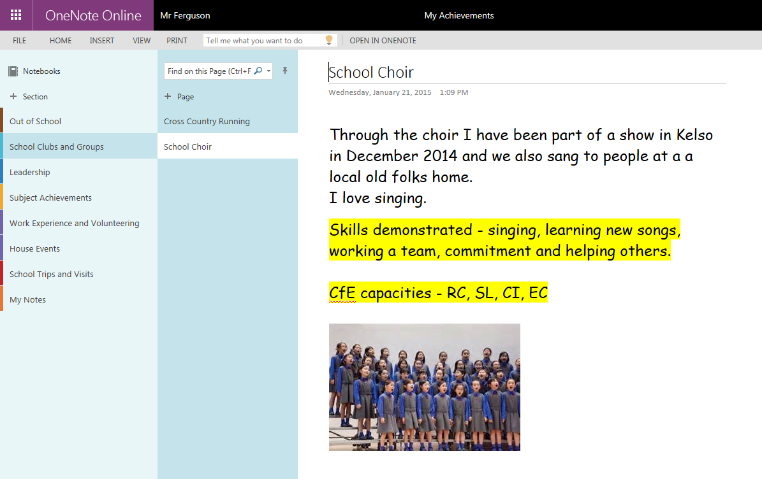
Example of P7 e-portfolio page

Slide 18
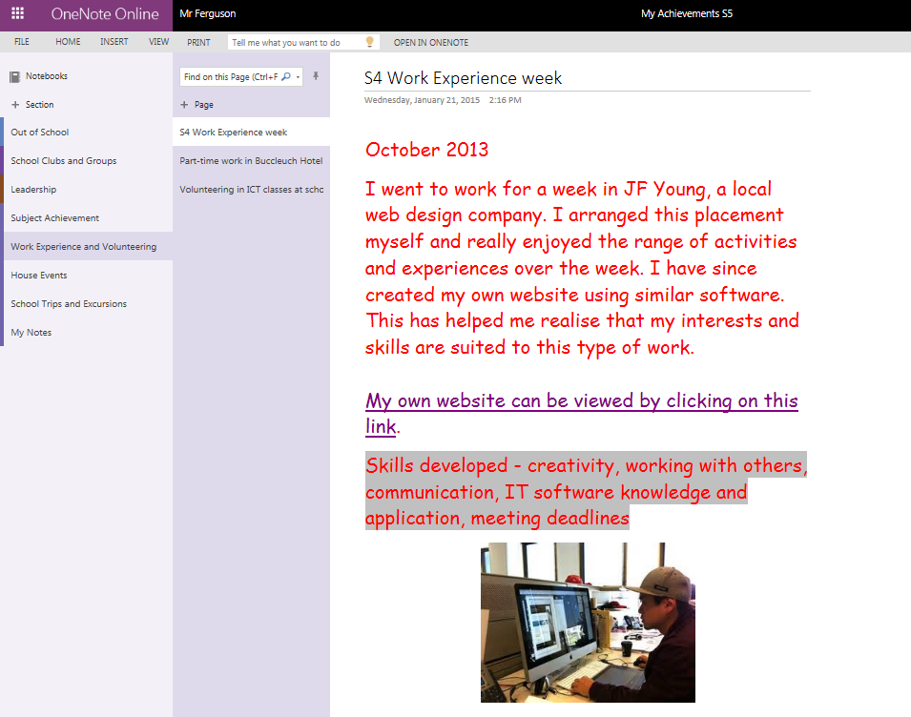
S4 Example Page

Slide 20
Essentially, the Learner Journey at EHS is all about how each individual engages with options, choices, opportunities and experiences that are available between entry and exit points (start and finish of school).
The key aim for our school is to ensure that each individual student leaves school with a positive destination that is fully appropriate to their personal skills, qualities, abilities and interests.
This destination should be the preferred option for the individual who should also be equipped with sustainable, transferable employability skills such as numeracy, ICT skills, teamwork, research skills, creativity and effective communication.
Destinations include college, university, employment, volunteering, Modern Apprenticeships, training and running your own business. These could also be considered as stepping stones towards the destination. Each places their particular demands of our youngsters but there are many overlapping areas that all of these establishments, bodies and society in general expect our students to possess.

Slide 21
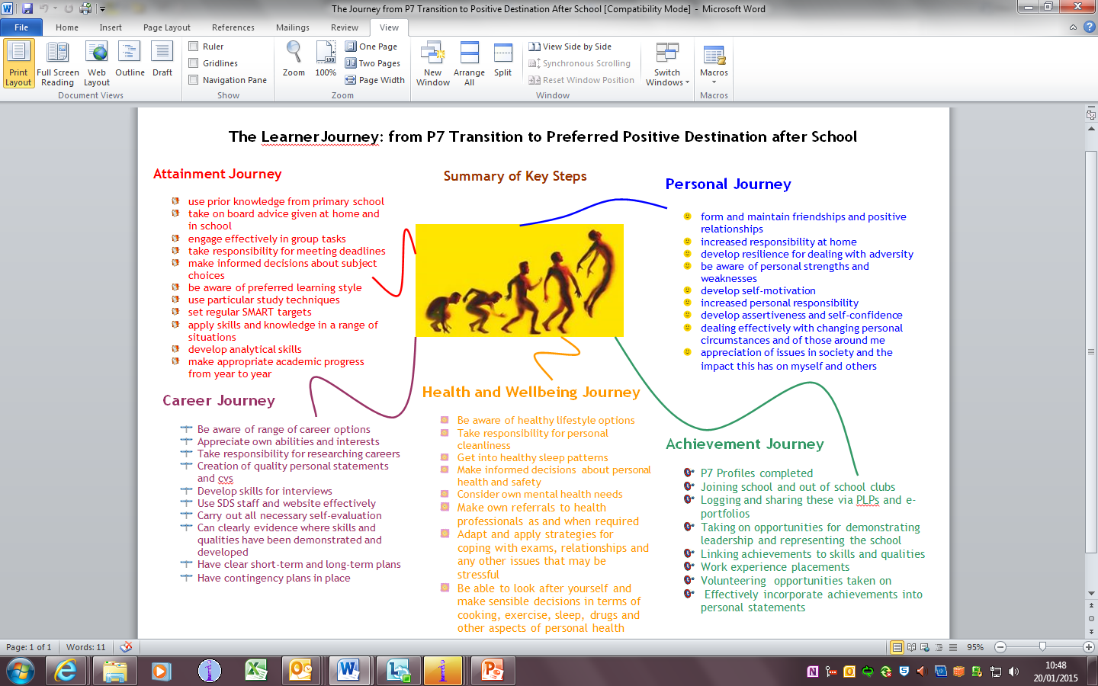

Slide 22
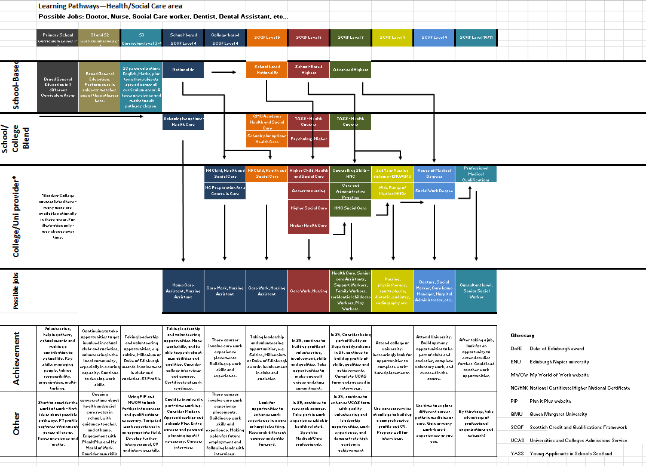

Slide 24
Rationale for Celebration of Success Evening
Recognising/rewarding achievements of individuals and/or groups
Emphasising the importance of Wider Achievement as a means of demonstrating and developing employability skills
In response to the recommendations of ’Commission for Developing Scotland’s Young Workforce’ Report – eg focus on skills, increased Business partnerships, promotion of range of post-school options
Further opportunity for partnership working – eg employers, volunteering, community groups
Highlight the positive impact of Curriculum for Excellence
To complement current award ceremonies – Leavers Evening and presentation of Dux Medals as well as more informal Faculty awards
Through publicity, encouraging students to get involved in wider achievement opportunities and to appreciate the benefits of these – being motivated and inspired by others
Promoting the Merit system and the House system
Similar events have been held up as excellent practice in other schools
Boost the self-esteem of those who are not necessarily high attainers

Slide 25
Planning for event
Awards/Categories
Winners
Sponsorship/Business Links
Promotion/Communication
Programme
Guests/Invitations
Media Group tasks
Head Team tasks
Parent Council involvement?

