Slide 1
Volunteer Centre borders
Tina Cameron,
Youth Development Officer
Notes:
Introduce VCB and my role
Matching agency – match volunteers to opportunities
Database of volunteers approx 3,800
Under 25’s approx 2,000 around 53% of registered volunteers
We will:
look at what volunteering is
the benefits of volunteering
opportunities, what’s available & how you can become involved
VCB Website
recognition and award schemes available to you and saltire website

Slide 2
What is volunteering?
When I think of volunteering I think of...............

Slide 3
What is volunteering?
commitment of time and energy,
unpaid
undertaken by choice
Notes:
You cannot be forced to volunteer
You should never be out of pocket
Although unpaid there are many benefits

Slide 4
Who benefits?
Organisations
Young People
Volunteers
Help into paid work
Improve Health
Increase confidence
Meet new people
Use spare time well
Good thing to do
Improve Things
Taster sessions
New experiences
learn new Skills
Share skills
Fun
College or university applications
Rewards and recognition
Charitable & not for profit organisations would find it difficult to exist without volunteers
Notes:
Organisations
Could not exist without volunteers of all ages
Volunteers
gain training/qualifications and develop new skills
opportunity to share skills, recieve training
Personal development
Give something back,
sense of achievement,
worthwhile cause, involvement in something that matters to you.
use spare time well,
Gain confidence.
Employment - Stepping stone to employment already part of team
Employment enhancers – benefits of volunteering
Training – certificates in land management, First aid etc
work skills – reliability, timekeeping, commitment, trustworthy, team working, flexibility, problem solving, leadership
Personal development – sense of achievement, self confidence, pride in work, self esteem
Young People
Try something, chance to change mind
Shows wider achievement on college /Uni applications
Nationally recognised Award certificates - CV

Slide 5
Volunteering opportunities
If I were to volunteer I would like to............

Slide 6
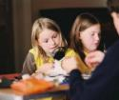
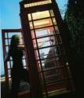
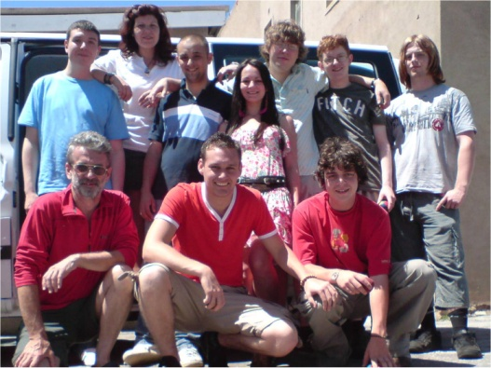
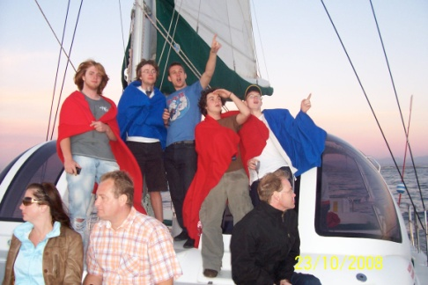
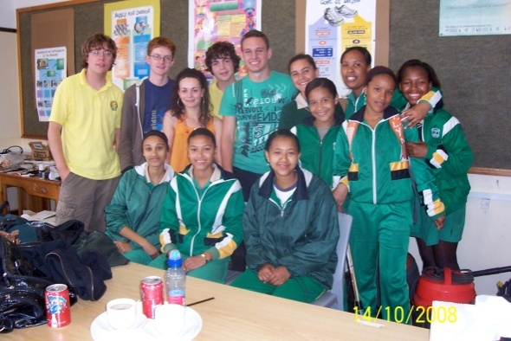
Volunteering opportunities
Admin & office
Advocacy
Animals
Arts
Children
Community Regeneration
Counselling & support
Drugs/Alcohol issues
Environment
Ethnic minorities
Families
Health, hospitals hospices
Learning disabilities
Mental health
Museum/galleries/ heritage
Older people
Physical disabilities
Rescue
Sensory impairment
Sport Outdoor activities
Women's / Men's groups
Young people
Notes:
My role to match and create opportunities approx over 1,500 with approx 750 currently active on database
Not there we can create it
Catagories - see registration form – blank space

Slide 7
How can you become involved?
Volunteer in school
Go directly to an Organisation
Contact overseas Organisations
Register with Volunteer centre
Search the web www.vcborders.org.uk
Notes:
Currently volunteer as classroom assistant, committees, out of school as part of curriculum free periods,
Direct to guides, scouts, sports clubs
International opportunities Volunteering abroad – Mandella, sailing – handout Overseas info.
VCB Registration forms
Benefit of VCB – monitor placement, find new opportunities, one off or team volunteering, ensure standards and fair treatment. Policies and best practice.

Slide 8
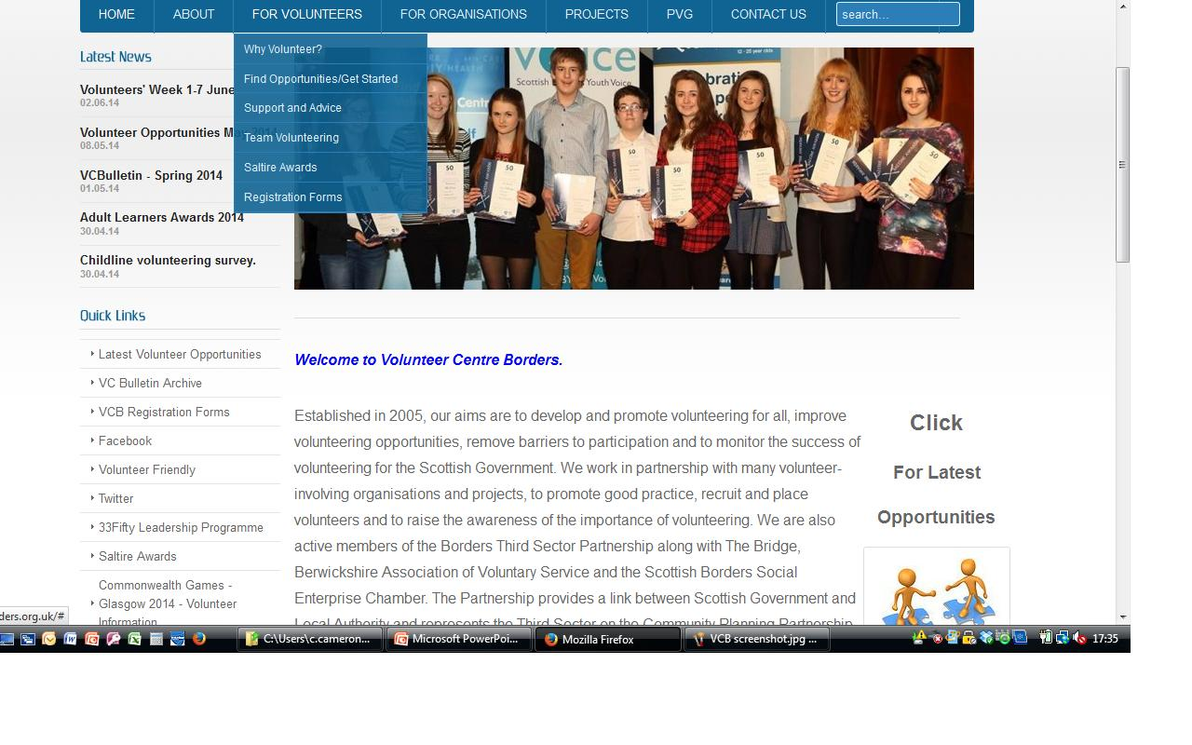
Notes:
Find opportunities / Get started
Click on Visit our online database of volunteering opportunities

Slide 9
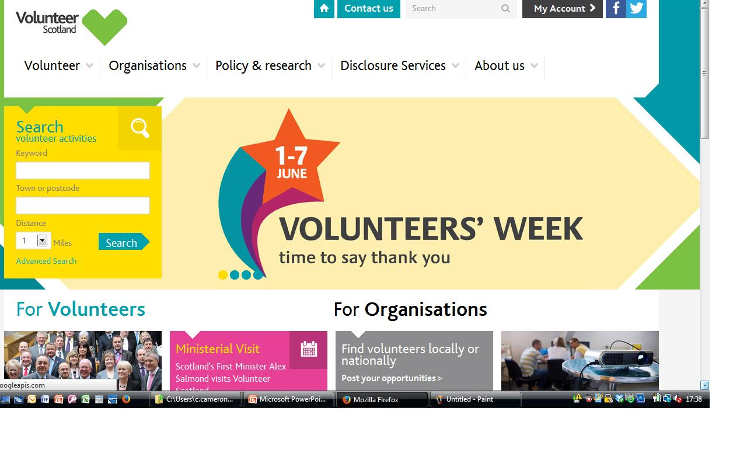
TD1

Slide 10
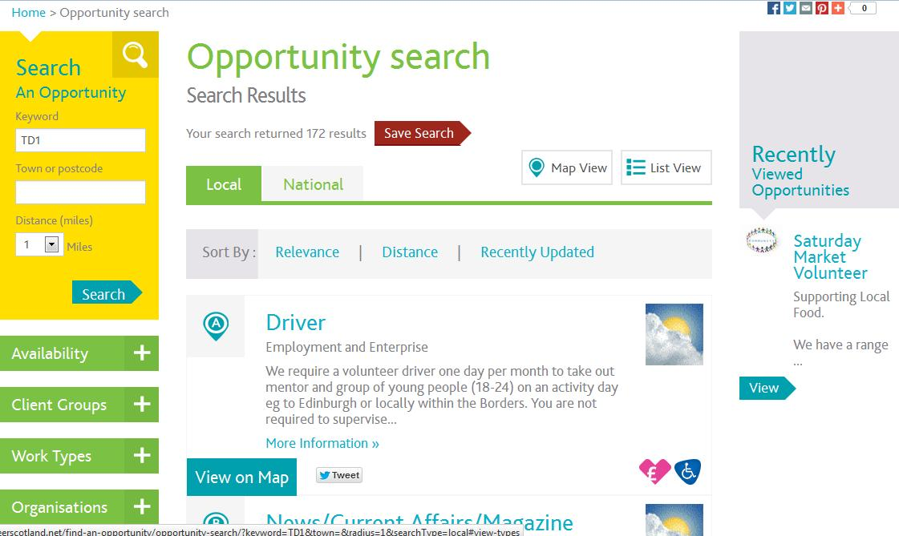

Slide 11
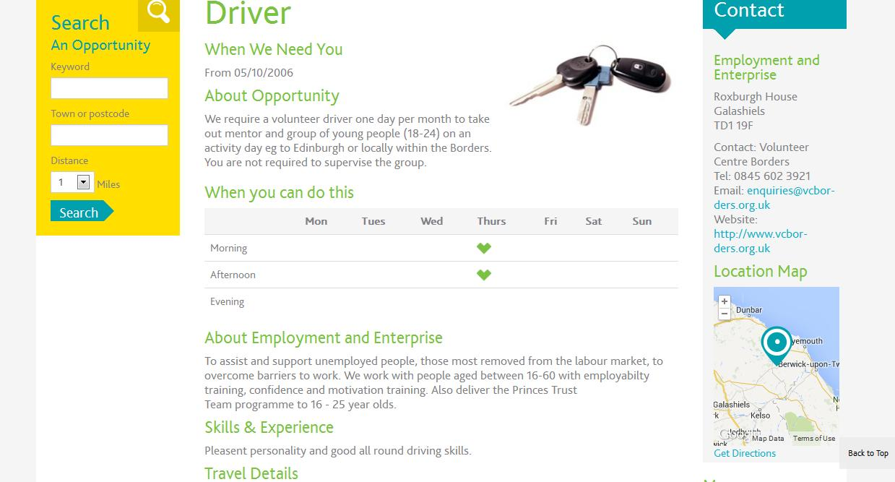

Slide 12
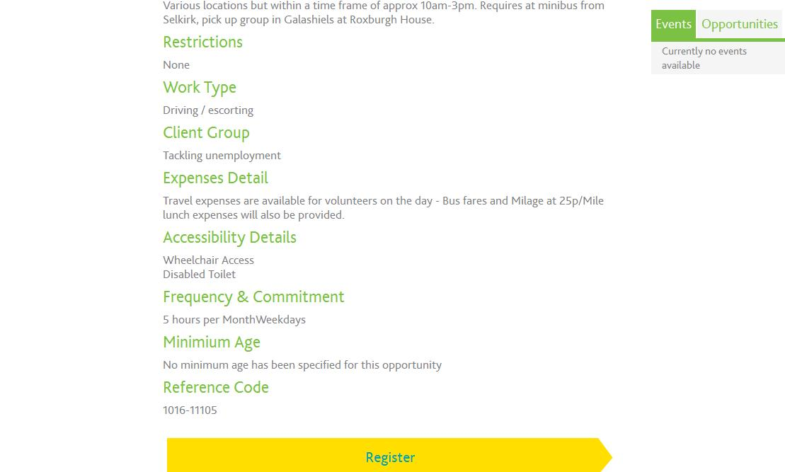

Slide 13
MY EXPERIENCES OF VOLUNTEERING
Frazer Pickering
Development Assistant
&
Saltire Ambassador

Slide 14
Notes:
Eyemouth High School’s Resilient Communities Film – 5m27s

Slide 16
Ambassador
Challenges Award- gentle introduction to volunteering
Approach – low achievable hours rewarding more volunteers
Ascent – up to 500 hour certificates for volunteering
Summit – recognising outstanding achievement
Ambassadors – continued involvement with Saltire
Summit
Ascent
Approach
Challenge
www.saltireawards.org.uk

Slide 17
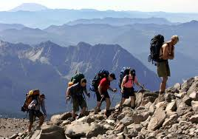
Introduction to volunteering
Part of a team
Stand alone award
Certificate on completion
Challenge

Slide 18
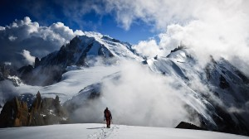
Encourages regular commitment
Realistic goals
Certificate at 10 then 25 hours
Approach
Challenge

Slide 19
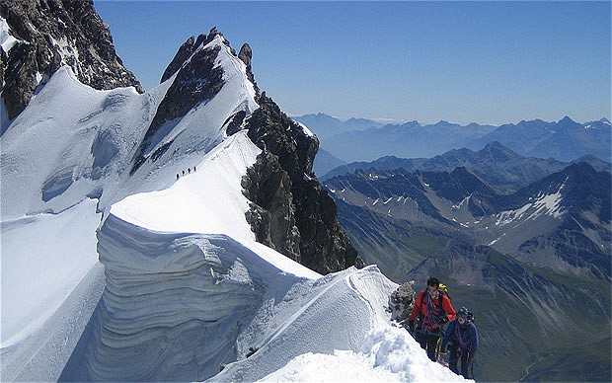
Sustained commitment to volunteering
Certificates at 50, 100, 200 & 500 hours
Ascent
Approach
Challenge

Slide 20
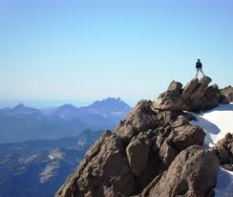
Nomination by organisation
Judged by a Panel of Saltire Ambassadors
Summit
Ascent
Approach
Challenge

Slide 21
Saltire Ambassadors
We would like to recruit at least one Saltire Ambassador per High School to
Promote Saltire Awards,
Distribute registration forms
Hold pop up sessions during breaks
Give presentations to year groups
Interested? –
email saltireawards@vcborders.org.uk
or talk to us after the presentation.
Notes:
Saltire Ambassadors: young people who have completed the 200 hour Ascent will be invited to become Saltire Ambassadors.
Ambassadors will have the opportunity to further develop and build upon skills such as planning, organisation, committee roles, communication and group work skills.
Ambassadors will be involved in the Saltire Award on every level from promotional and publicity activities through to decision making roles on the Summit Award panel and the assisting in the organisation of The Annual Youth Award ceremony.
Volunteer Centre Borders is working in partnership with Scottish Borders Youth Voice to deliver the Scottish Borders Annual Youth Awards event. The event will recognise volunteering achievement through Saltire certificate distribution and also wider achievement of young people in the Borders through the Inspire awards. The Inspire awards are to recognise the contribution of young people in areas such as Sport, Community, Music and arts etc and young people can be nominated for these awards.
We are currently recruiting young people to meet in their local area each week to assist in promoting this event and to manage local nominations for the Inspire award. They will also have a say in how the event will be organised and to fundraise.

Slide 22
Advantages To You
Hours can be submitted online
Can be backdated for up to 2 years!
Young Scot points for each certificate
Nationally Recognised Awards to go onto your CV
Resume if you drop off

Slide 24
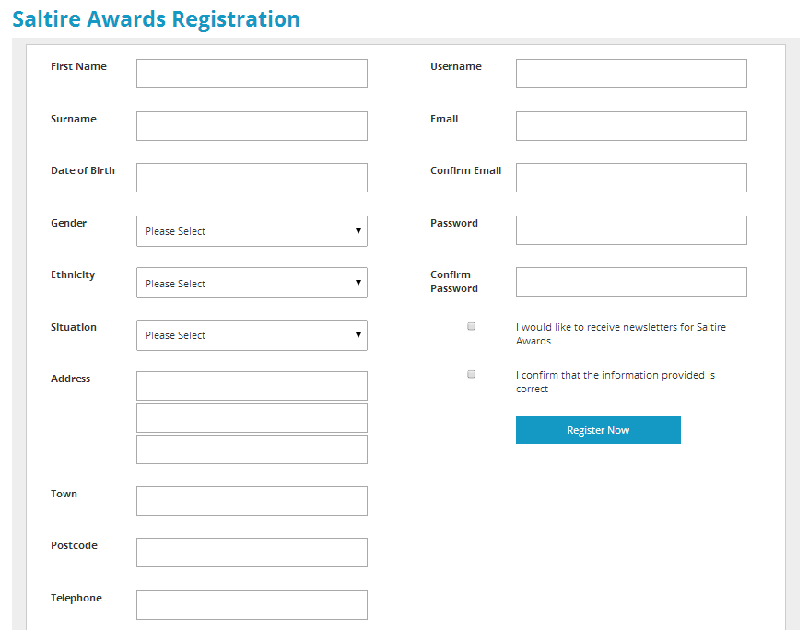

Slide 25
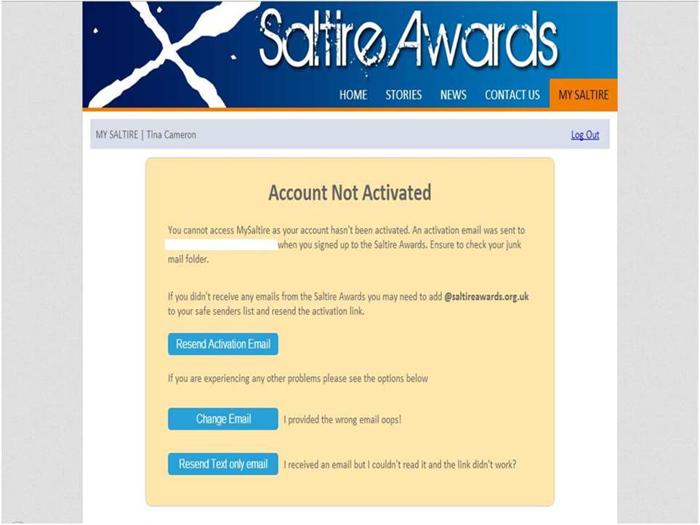

Slide 26
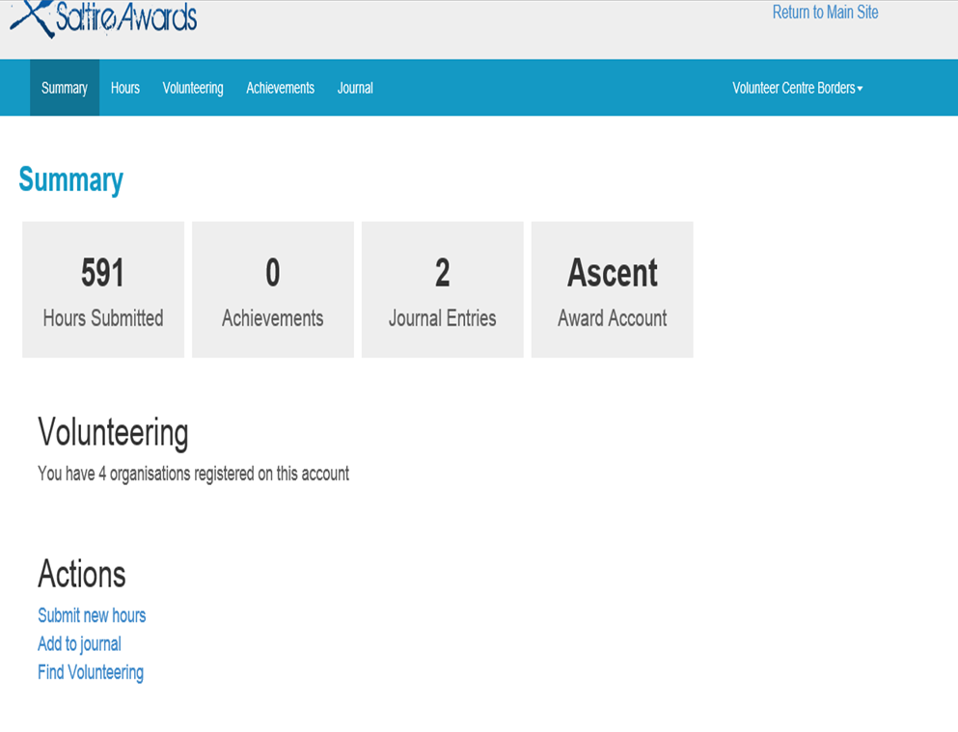

Slide 27
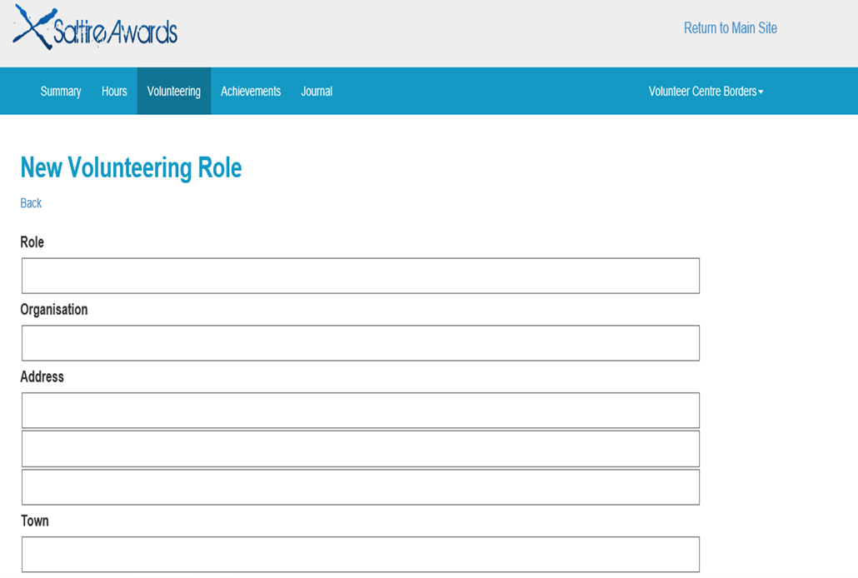

Slide 28
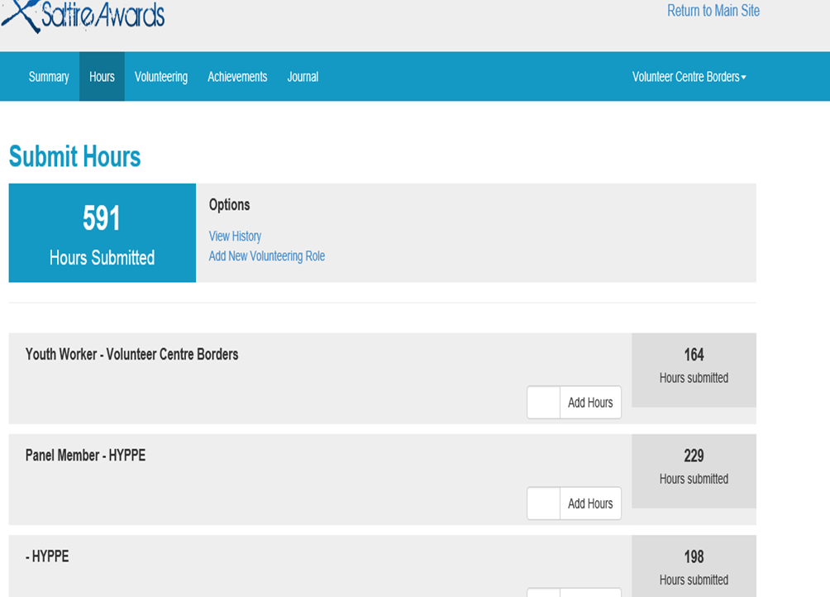

Slide 29
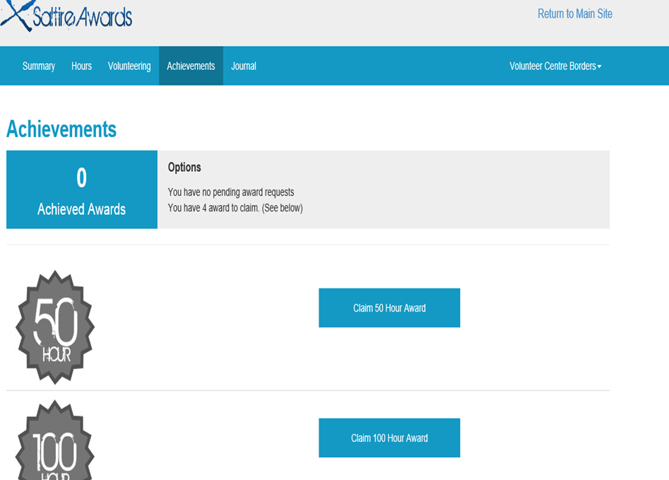

Slide 30
Summit
Ascent
Approach
Challenge

Slide 31
Were You Listening?
What is a benefit to you of volunteering?
How can you become involved?
What is the name of the award scheme?
Name one of the certificates you can achieve?

Slide 32
Want more information about Saltire?
Have you Volunteered in the past and didn’t receive recognition?
or
Are you interested in Volunteering now?
Come and
see us!

Slide 33
Thank You
For
Listening
☺
Any Question?

Slide 34
Volunteer Centre Borders
Ladhope Vale
Galashiels
Tel: 0845 602 3921
Web site: www.vcborders.org.uk
www.saltireawards.org.uk
Email:
Saltireawards@vcborders.org.uk

